Slide 1
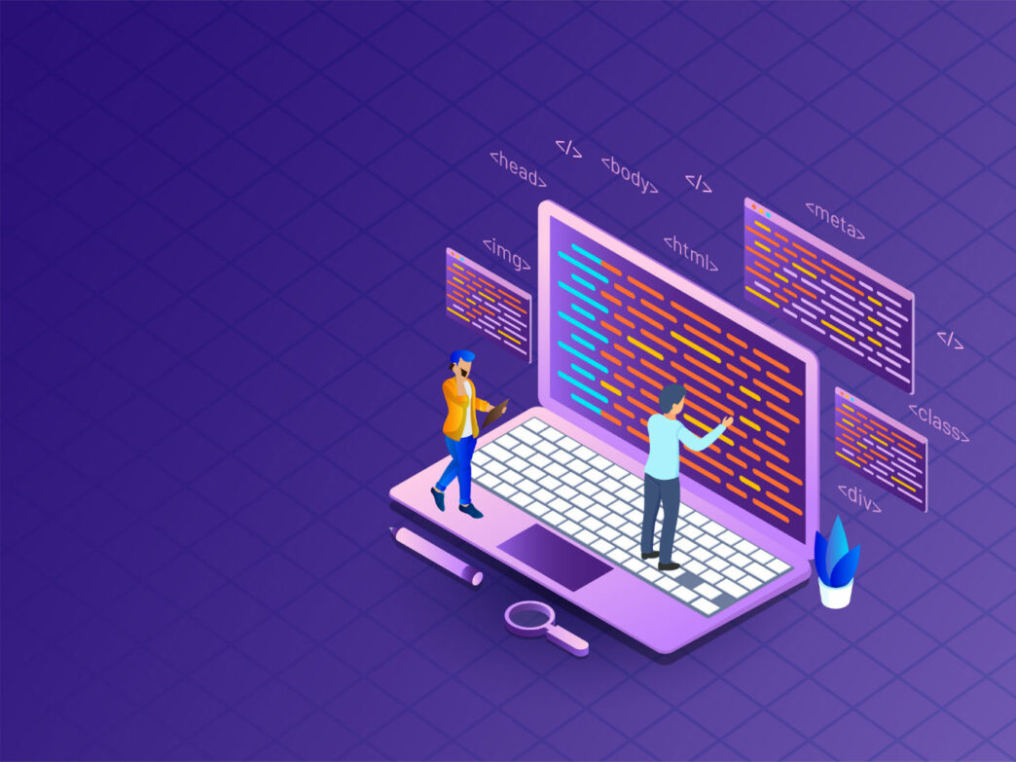




LICET PATTARAI
LOYOLA-ICAM COLLEGE OF
ENGINEERING AND TECHNOLOGY
PATTARAI’S WORKSHOP
ON
Backend Web Development with express
.js
Date:
Time:
27.01.2022
6pm-7pm

